Slide 1
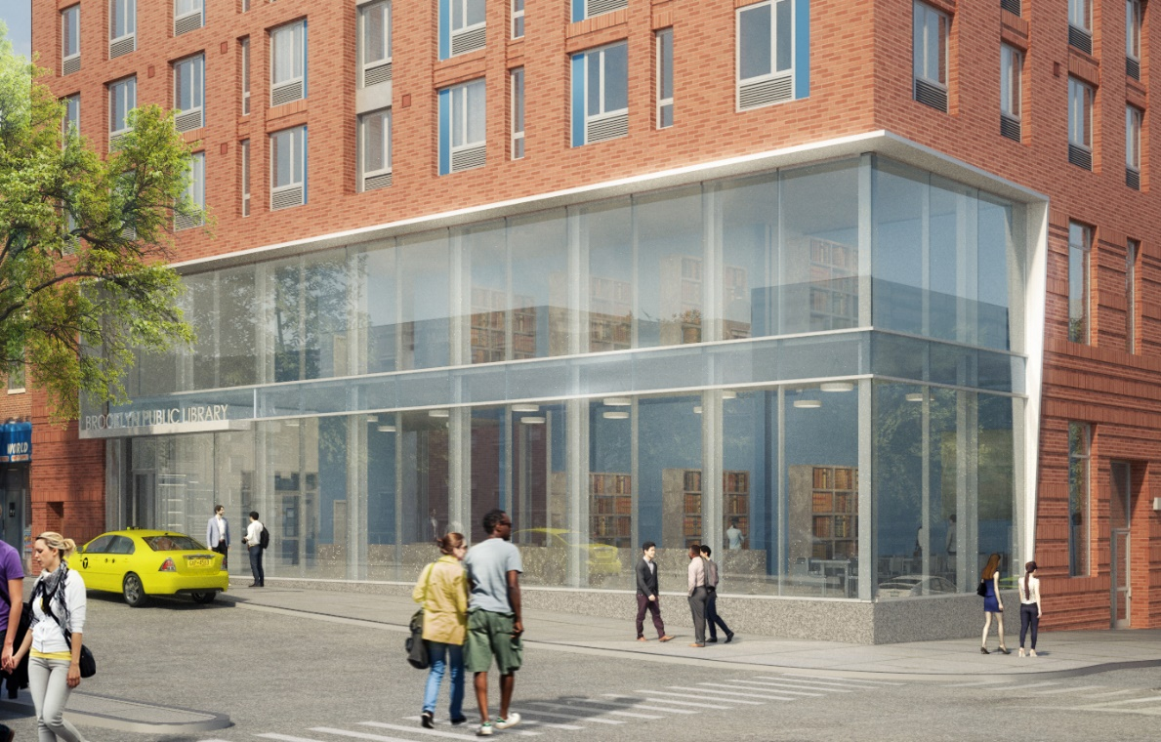
Sunset Park Library & Affordable Housing Project
Community Information Session
51 st
st
th
AVE
4

Slide 2
Agenda
Overview
Amenities & Services
Project Design
What is ‘Affordable Housing’?
Affordability Levels and Rents
How to Apply for Affordable Housing
Next Steps: Timeline
Frequently Ask Questions

Slide 3
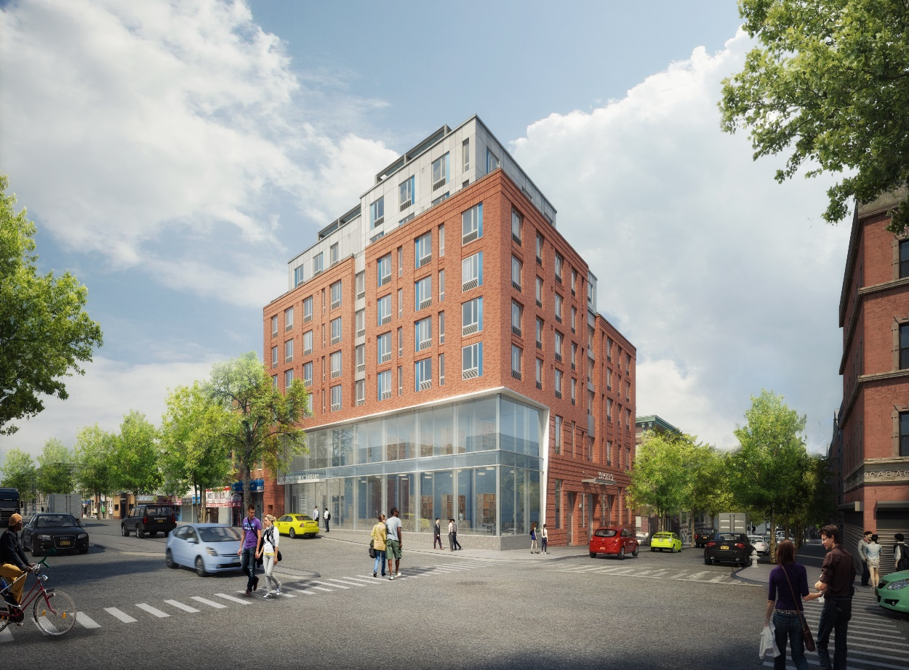
Overview
8 story building
Library – approximately 20,000 square feet on multiple floors
Residential Apartments - a
portion of 2nd floor and 3rd
through 8th floors
50 Apartments
11 studio
13 1 BR
13 2 BR (+ 1 super’s unit)
12 3 BR

Slide 4
Amenities & Services
Sunset Park Public Library on site
Laundry room and 2nd floor roof deck
Building is located within blocks of public transit, shopping, schools, hospital, parks and employment hubs

Slide 5
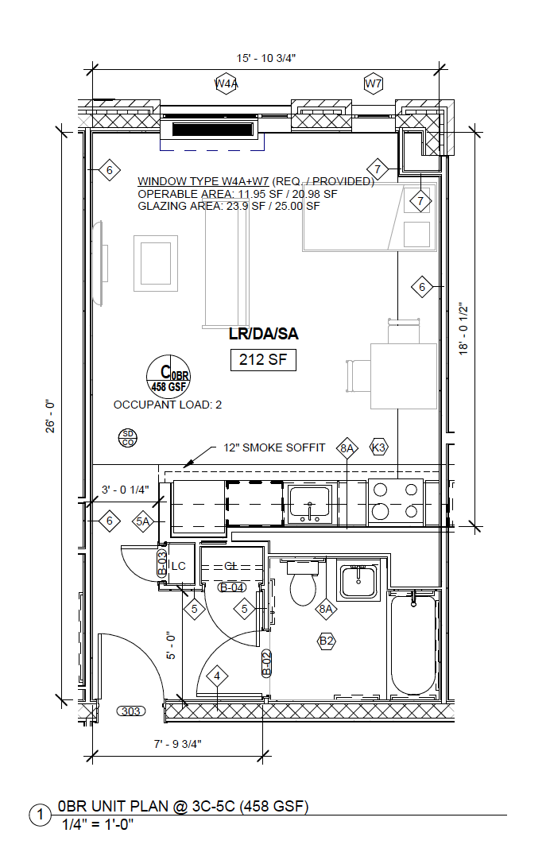
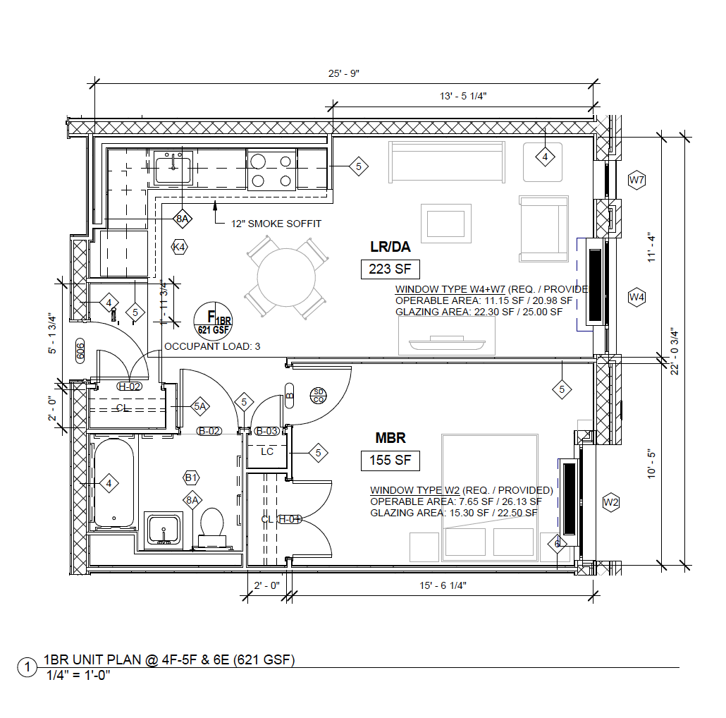
Studio & 1-Bedroom Apartment Plans

Slide 6
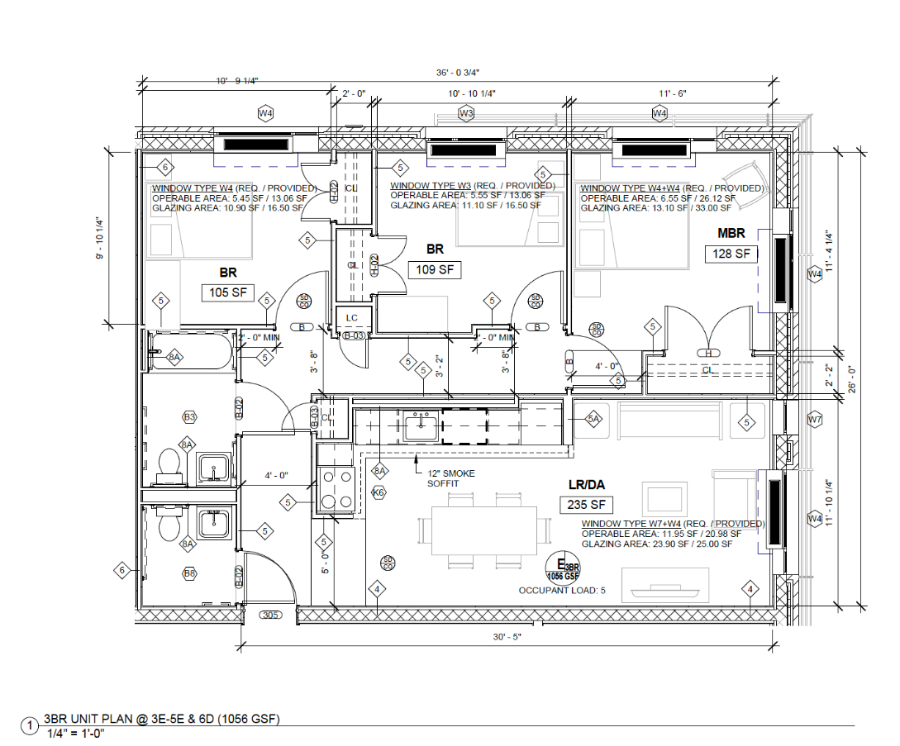
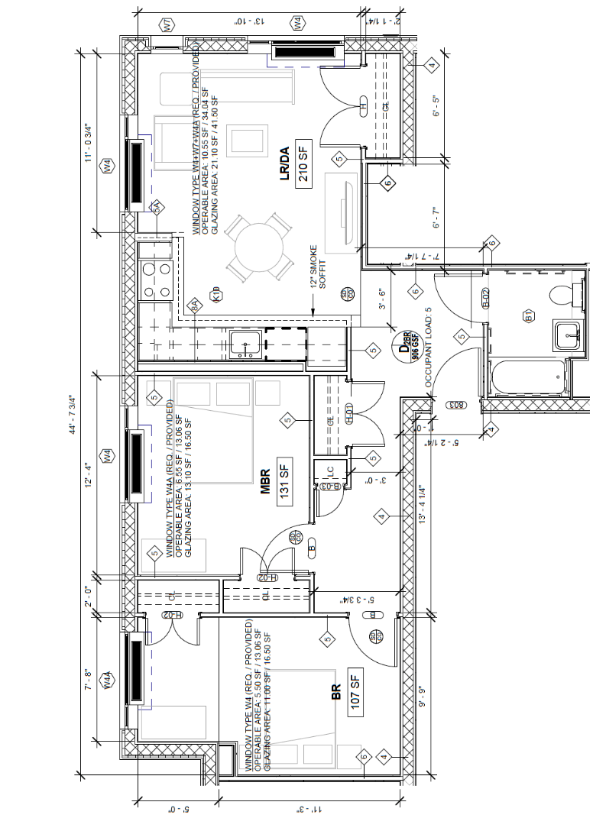
2- and 3-Bedroom Apartment Plans
More floor plans

Slide 7
What is Affordable Housing?
Housing is considered “affordable” when a household* spends no more than
1/3 of its income on rent and utilities.
If your gross income is… | Your monthly rent should be approximately:
$20,000 | $600
$50,000 | $1,500
$100,000 edit | $2,500
Notes:
HOUSING IS CONSIDER AFFORDABLE WHEN A FAMILY OR HH SPENDS NO MORE THAN A THIRD OF THEIR GROSS INCOME ON RENT AND UTILITIES.
HERE WE HAVE NICE ROUND EXAMPLES OF WHAT THE APPROX RENTAL EXPENSES MIGHT BE FOR THESE GROSS INCOMES. BUT WE KNOW THAT THERE VARYING FACTORS THAT IMPACT AFFORDABILITY, like the number of people in your household.

Slide 8
What is Affordable Housing Continued
Area Median Income (AMI) is determined each year by the federal government for different regions.
New York Metro Area :
100% AMI
$102,400
for a family of three
(2020)
Notes:
AND THAT’S WHER AMI OR AREA MEDIAN INCOME COME IN. THIS IS A NUMBER THAT ACTS AS AN INDICATOR, BASED ON YOUR HOUSEHOLD SIZE, OF WHAT INCOME CATEGORY YOU FALLS INTO.
FOR 2020 THE MEDIAN INCOME FOR A FAMILY OF 3 IS JUST OVER $100K

Slide 9
What is Affordable Housing Continued
NYC and NYS use this number as a point of reference and sets its own income requirements tailored to the needs of New Yorkers.
100% AMI
$30,720
$61,440
$81,920
$133,120
30% AMI
60% AMI
80% AMI
130% AMI
Retail Salesperson
Taxi Driver + Janitor
Caseworker + Home Health Aide
Teacher + Firefighter
$102,400
for a family of three
(2020)
Notes:
HPD USES AMI AS A POINT OF REFERENCE TO DETERMINE IT’S OWN INCOME ELIGIBILITY REQUIREMENTS. AND OUR PROGRAMS ARE MEANT TO SERVE THE NEEDS OF A WIDE RANGE OF INCOMES AND FAMILY TYPES.
THE INCOMES SHOWN ON YOUR SCREEN SHOW EXAMPLES OF EXTREMELY LOW TO MODERATE INCOME LIMITS OF 3 PERSON HOUSEHOLDS. BUT WE’LL GET INTO DIFFERENT HOUSEHOLD SIZES WITH VARYING INCOMES LATER ON IN OUR PRESENTATION.
IN THE MEANTIME, IF YOU ARE WONDERING WHERE YOUR HH FALLS ON THE SPECTRUM OF INCOMES, WE’RE SHARING A LINK TO A GRAPHIC THAT CAN HELP YOU DECIDE BASED ON YOUR FAMILY SITUATION

Slide 10
What is Affordable Housing Continued
Sample Rents for Affordable Housing
Example Households
Apartment Size | Studio |  | 1 BR | 2 BR |  | 3 BR
Annual Income | Social Security (Senior) | $23,880 (30% of AMI) | $72,800 (80% of AMI) | $45,500 (50% of AMI) | $40,960 (40% of AMI) | $68,220 (60% of AMI)
Sample HPD Rent | 30% of income | $397 | $1,570 | $1,110 | $854 | $1,570
Sample Market Rate Rent* | $1,905 |  | $2,330 | $2,892 | 2 BR $2,892 | $3,020
*Market rate rents based on StreetEasy search in Gowanus, Park Slope, Boerum Hill, and Carroll Gardens on Nov. 16, 2020
Notes:
Additional example: 2 BR HPD sample rent at 100% AMI is $2,467
If asked for Gowanus specific listings, a Nov. 16 Streeteasy search found the following:
Studio: $2,700
1BR: $2,540
2BR: $3,400
3BR: $2,980

Slide 11
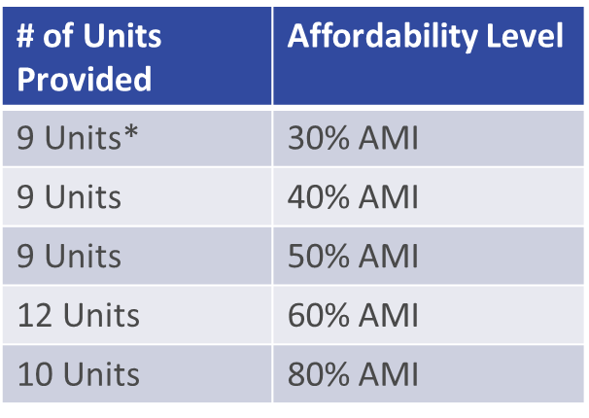
Affordable Housing at Sunset Park Project
The Sunset Park Library & Affordable Housing Project is 100% affordable, and rents are targeted to meet the needs of local families earning between 30% and 80% of Area Median Income (AMI).

Slide 12
New NYC Housing Connect 2.0
NYC Housing Connect (housingconnect.nyc.gov)is New Yorkers' portal to find and apply for affordable housing opportunities across the five boroughs of New York City.
In July 2020, HPD and HDC launched a new version of NYC Housing Connect. They’ve taken your feedback and designed the website to make the affordable housing application process easier, more accessible, and user-friendly.
You need create a new account on the new NYC Housing Connect in order to apply for affordable housing if you have not already done so.
If you have an account on the original NYC Housing Connect, your applicant profile information will not be carried over to the new website.

Slide 13
How to Apply for Affordable Housing

Slide 14
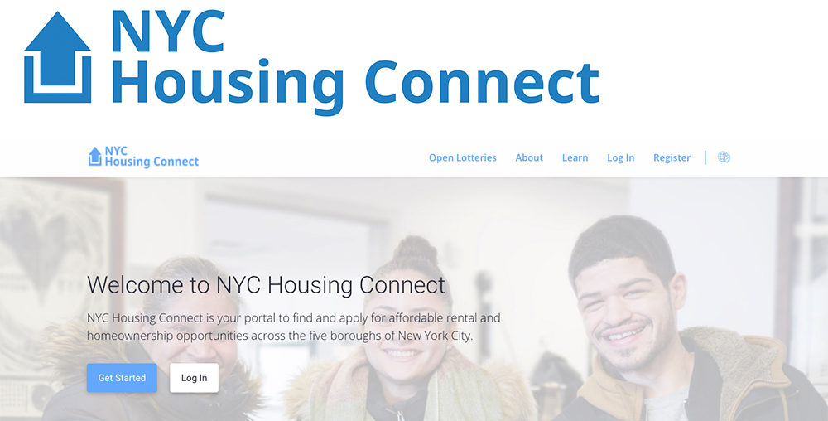
Applying For Affordable Housing

Slide 15
Sample- HC 2.0 Application website

Slide 16
Sample – unit and Eligibility Requirements

Slide 17
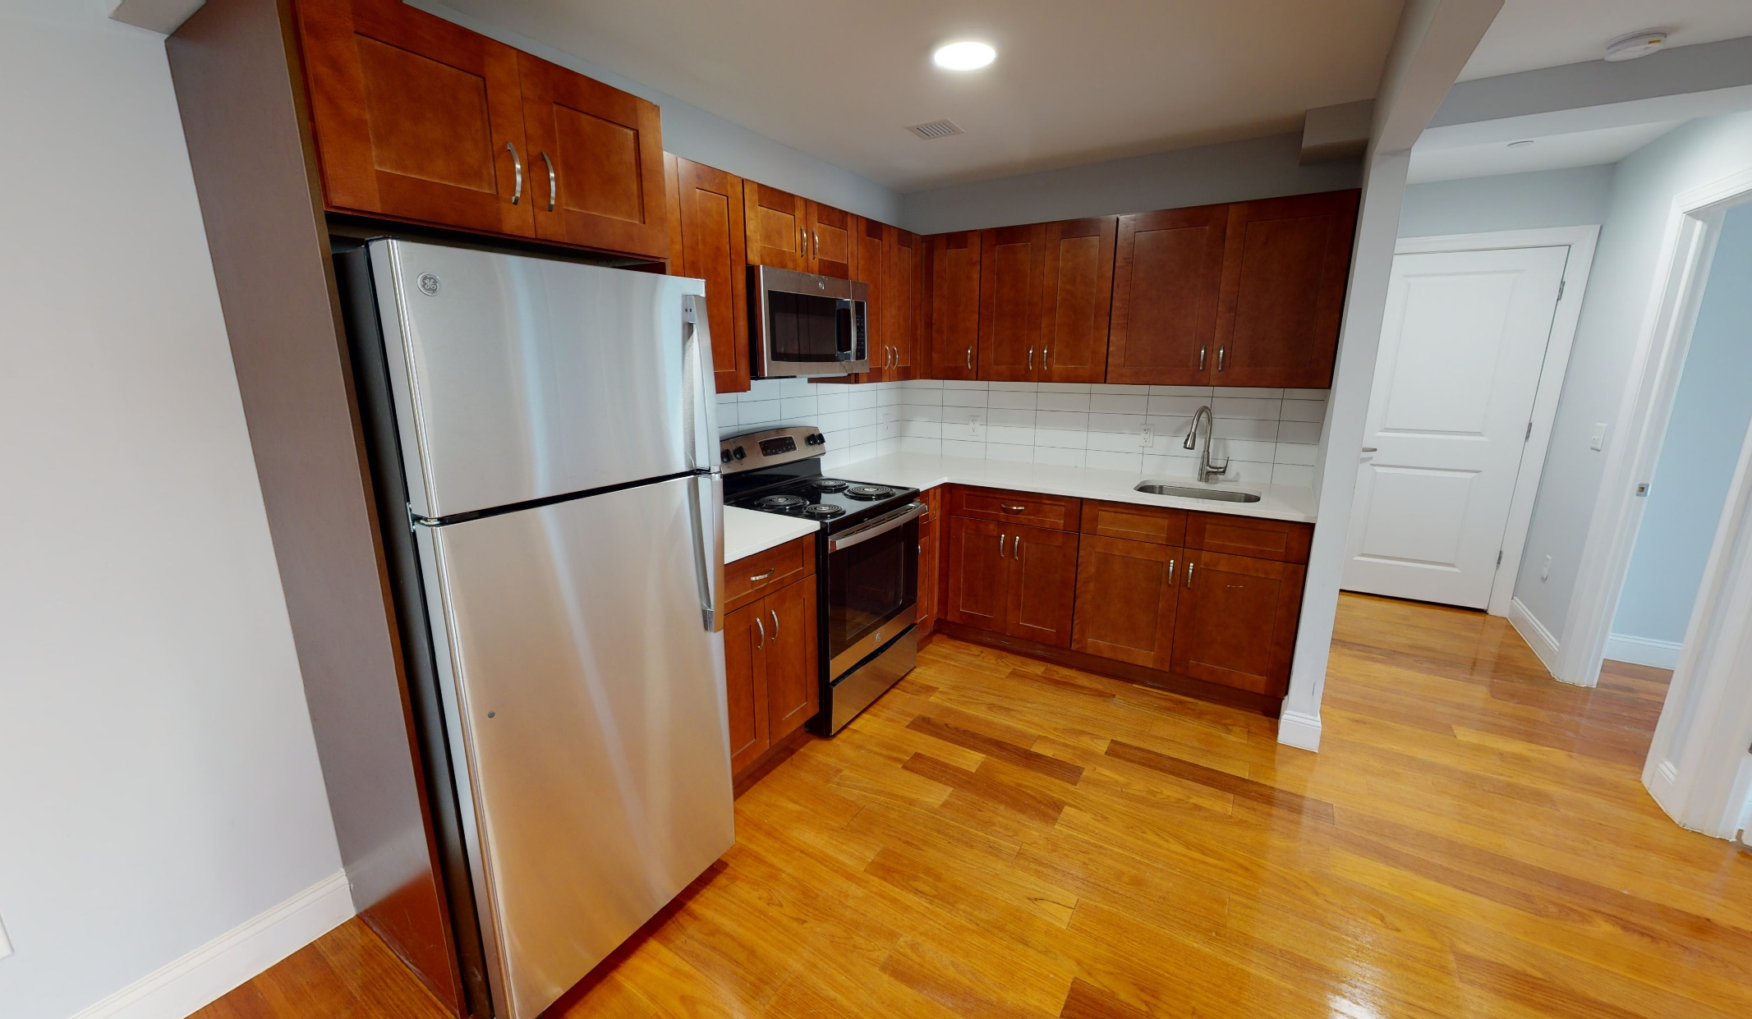
Sample -view of the units

Slide 18
Required Documentation For Proof Of Income
Copies of original most recent documents: 4/6 most recent paystubs (Consecutive weekly/Biweekly) Previous years’ W-2 forms (all pages) Signed & completed most recent Federal and State Tax returns Social Security Award Letter(s) (no older than 30 days) Public Assistance budget letters (no older than 120 days old) 6 Bank Statements -Savings, Checking, Money Market Letter from all former employers in the current year and prior year, stating last date of employment

Slide 19
Frequently Asked Questions
Is there an application fee?
There is no fee to apply for housing using Housing Connect. You may be charged a non-refundable credit/background check fee.
Where can I apply?
The link is https://housingconnect.nyc.gov/PublicWeb/ and it will lead you to the Housing Connect Portal where you will find various listings, including our Sunset Park Library Project. You can look on the website for helps on how to create your profile and apply.
What if I don't want to apply online?
Online applications are the only applications being considered for the Sunset Park Library Project. Although you may find other open lotteries that may consider paper applications, but you will have to review the details of each open lottery advertisements to check.
Once I submit my application, can I make changes?
Yes. It is very important that you update your household and income information in NYC Housing Connect every time there is a change.

Slide 20
Frequently Asked Questions
How is income calculated?
Income is calculated by annual gross income. You must indicate ALL sources of income for ALL household members who will be living in the unit for which you are applying. Your annual gross income includes all sources of employment income and other income such as social security for each member of your household. For self-employed applicants, net income (Gross Income minus Expenses/Other Deductions) is analyzed
Can I submit my application after the deadline?
Applications submitted after the deadline will not be considered.
What happens after I apply?
Once the deadline passes, each application gets a random number—a lottery log number. Lottery log numbers are random. No one controls who has a better or worse number. Randomly selected applications then get reviewed.
Can I submit my application after the deadline?
Applications submitted after the deadline will not be considered.

Slide 21
Questions & Comments
Thank you

